Slide 1
SCHOOL LUNCH!
OFFER
vs.
SERVE

Slide 2
Lunch Meal Pattern Components ?
1- Meat/ 3- Veggies
Meat Alt.
2- Grains 4- Fruit
5- Milk
Notes:
-First we will cover the basic components for the Lunch Meal Pattern.
-There are 5 Food Components that comprise the Reimbursable Menu Pattern Lunch.
-These include:
1-Meat/Meat Alternate
2-Grains
3-Veggies
4-Fruit
5-Milk

Slide 3

MEAT/MEAT ALT.
Minimums/
day & week
Notes:
-The Meat/Meat Alternate Food Component must be offered daily.
-This group contains daily and weekly minimums for each specific grade group.

Slide 4
GRAINS
Must Be
WHOLE GRAIN RICH WGR
Minimums/day
Minimums/week
Notes:
-The Grains Food Component must be offered daily.
-All Grains Must be Whole Grain-Rich.
-This group contains daily and weekly minimums for each specific grade group.

Slide 5
VEGGIES
Required Sub-Groups
Dark Green
Red/Orange
Beans/Peas
Starchy
Other
Notes:
-The Vegetable Food Component also requires that you serve specific weekly amounts of Vegetable Sub-Groups .
-The Vegetable Sub-Groups are as follows:
Dark Green
Red/Orange
Beans/Peas
Starchy
Other

Slide 6
VEGGIES
Minimums/
day & week
1 cup Leafy Greens
= ½ cup Creditable
Notes:
-The Vegetable Food Component must be offered daily.
-This group contains daily and weekly minimums for each specific grade group.
-As a reminder if you offer Leafy Greens such as Romaine Lettuce, Raw Spinach, Iceberg Lettuce , Kale etc., their creditable amount towards the vegetable component is half their portion size.
Example: 1 cup Portion of Romaine = ½ cup of the Creditable Vegetable Component.

Slide 7
FRUIT
Minimums/
day & week
100% Juice ---
Only Allowed for
½ of weekly requirement
¼ cup dried =
½ cup
Notes:
-The Fruit Food Component must be offered daily.
-This group contains daily and weekly minimums for each specific grade group.
-100% Juice can only be offered to meet up to ½ or 50% of the weekly Fruit requirements.
-As a reminder if you offer Dried Fruits such as Raisins, Craisins, Dried Cherries etc., their creditable portion towards the fruit component is double their portion size.
Example: ¼ cup Portion of Raisins = ½ cup of the Creditable Fruit Component.

Slide 8
MILK
➢Unflavored Fat Free
➢Unflavored 1%
➢Flavored Fat Free
➢Offer 2
Notes:
-The Milk Food Component must be offered daily.
-The Varieties of milk that are allowable are as follows:
Unflavored Fat Free often referred to as Skim Milk
Unflavored or White 1% Low Fat Milk
Flavored Fat Free such as Fat Free Chocolate or Fat Free Strawberry
-Two different varieties from these 3 categories must be offered to students daily at lunch.

Slide 9

OFFER vs. SERVE??
WHY
Reduces Food Waste!
Provides Students Freedom of Choice
Notes:
-The “Offer vs. Serve” regulation was implemented back during President Ford’s period in office in an effort to stop feeding the trash cans and instead feed our children’s mouths and provide them with nourishment.
-The Goals of this regulation are as follows:
Reduces Food Waste!
Provides Students Freedom of Choice to Select Foods They will Eat

Slide 10

Offer vs. Serve
Mandatory for Senior HS
Optional for Elementary & MS
Notes:
-The “Offer vs. Serve” regulation is Mandatory for Senior High Schools.
-This regulation is Optional for Elementary Schools and Middle Schools.

Slide 11
Unit Pricing??
Set One Price for Complete Reimbursable Meal
(For Paid & Reduced Categories)
Can Set Different Paid Prices for Various Meal Combos
(Free & Reduced-Price Students Must Be Permitted to Choose these Meals at No Additional Cost)
Charge Same Price as Unit Meal whether Student Selects
3, 4 or 5 Food Components
Notes:
Unit Pricing:
Set One Price for a Complete Reimbursable Meal for the Paid category and Reduced category.
Can Set Different Paid Prices for Various Meal Combos.
(Free & Reduced-Price Students Must Be Permitted to Choose these Meals at No Additional Cost)
Charge Same Price as Unit Meal whether Student Selects 3, 4 or 5 Food Components

Slide 12
Pricing??
Establish Prices for A la Carte Menu Items to Cover All Costs of Producing Them
Be Sure Prices for A La Carte Menu Items when Correctly Combined are Higher than Unit Price of the Reimbursable Lunch
Example
Sample Reimbursable Lunch Price: $3.00
A La Carte Hot Dog: $2.50
A La Carte Orange: .75
A La Carte Hot Dog & Orange = $3.25
Student Benefits by Selecting Reimbursable Lunch !
Notes:
Pricing:
-Establish Prices for A la Carte Menu Items to Cover All Costs of Producing Them.
- Be Sure Prices for A La Carte Menu Items, when Correctly Combined, are Higher than the Unit Price of the Reimbursable Lunch.
Example
Sample Reimbursable Lunch Price: $3.00
A La Carte Hot Dog: $2.50
A La Carte Orange :.75
A La Carte Hot Dog & Orange = $3.25
Student Benefits by Selecting Unit Lunch which is $3.00!

Slide 13
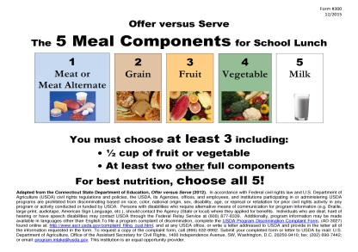
SIGNAGE
Communicate What Constitutes Meal to Students; Servers/Cashiers; Parents/Guardians
Identify What Comprises Reimbursable Meal --- Menus/Signs/Newsletters
(Example: If HS students can choose 2 each of ½ cups of fruit, display a sign stating this choice near fruit on serving line.)
Post Signs at Beginning or Near Serving Lines
Display Offer vs. Serve Signage, Form #300
http://www.nj.gov/agriculture/divisions/fn/pdf/form300.pdf
Notes:
Signage & Correspondence:
Communicate What Constitutes a Meal to Students; Servers/Cashiers; Parents/Guardians.
Identify What Comprises Reimbursable Meal --- Menus/Signs/Newsletters.
(Example: If HS students can choose 2 each ½ cups of fruit, display a sign stating this choice near fruit on serving line.)
Post Signs at Beginning or Near Serving Lines.
Display Offer vs. Serve Signage, Form #300.
http://www.nj.gov/agriculture/divisions/fn/pdf/form300.pdf

Slide 14

Offer vs. Serve/Form #300
Available at: http://www.nj.gov/agriculture/divisions/fn/pdf/form300.pdf
Notes:
Offer vs. Serve Signage, Form #300.
Available at the web site listed on this slide.

Slide 15


TRAINING
Conduct Training for Food Service Staff
Reinforce with Cashiers & Servers
Meets Professional Standard Requirements
Notes:
Training:
Conduct Training for Food Service Staff.
Reinforce with Cashiers & Servers. This is very important for Meal Accountability.
Servers and cashiers can help students correctly select the foods comprising a reimbursable meal.
Training offered on this specific topic Meets Professional Standard Requirements.

Slide 16
OFFER vs. SERVE??
Implementing “Offer vs. Serve” for Lunch
Must Take 3 Components
MUST take:
½ c Fruit or
½ c Veggie or
½ c Fruit/Veggie
Plus 2 Complete Components
Notes:
Offer vs. Serve:
-Must take total of 3 Components.
-Must take ½ cup of Fruit, Vegetable Or Combination of Fruit & Vegetables.
-Plus 2 Complete Components. By Complete we mean the Minimum Daily Requirement as specified for each grade group.

Slide 17
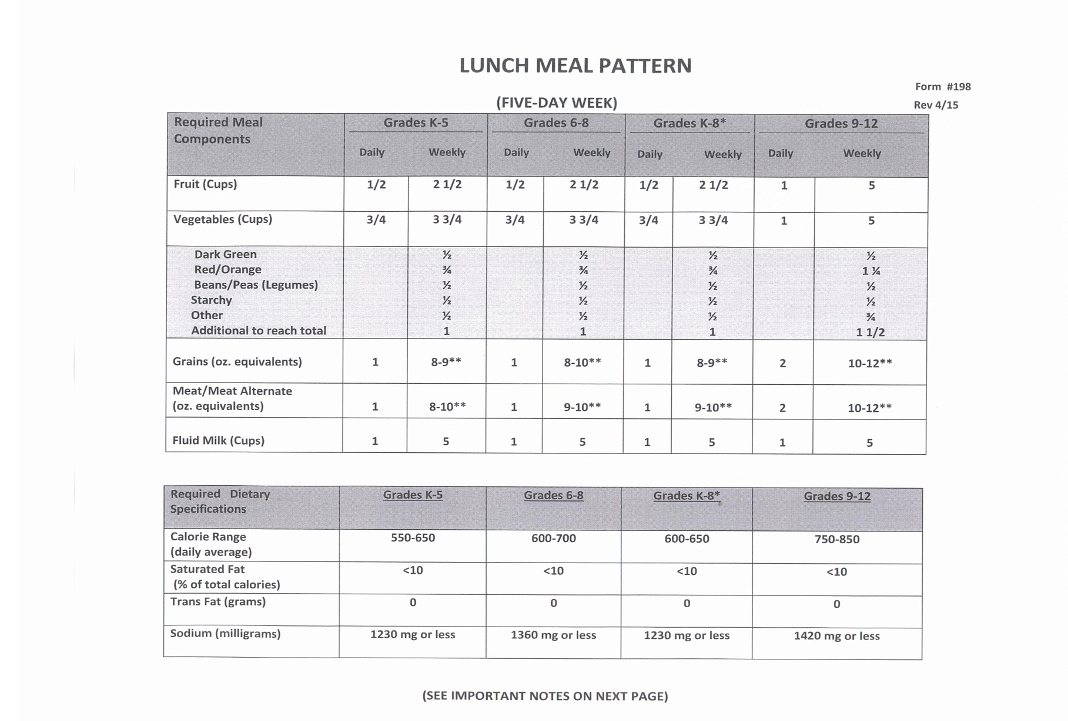
LUNCH Meal Pattern ?
http://www.nj.gov/agriculture/divisions/fn/pdf/form198.pdf
Notes:
-This is the Lunch Meal Pattern for all grade groups.
-This form contains the Daily & Weekly Requirements for all Food Components by Grade Groups.
-At the bottom of this page it reads “See Important Notes On Next Page” . The additional pages include specific details for each of the Food Components comprising the Lunch Meal Pattern.
-This can be found at the web site listed at the bottom of this slide.
-There are Additional Lunch Patterns for 4 , 6 and 7 day weeks.

Slide 18
Components vs.
Items ??
Food Component: 5 Food Groups
Meat/Meat Alternate
Grains
Fruit
Vegetables
Milk
Must Offer All 5 in
Minimum Quantities Daily
Notes:
Components vs. Items?
Food Components
-A Food Component is one of the 5 Food Groups.
-The 5 food components are as follows:
Meat/Meat Alternate
Grains
Fruit
Vegetables
Milk
-These 5 components must be offered Daily.
-These Components must be offered at the Minimum Quantities as specified for each grade group.
-Remember your menu must also meet the minimum weekly requirements for all food components.

Slide 19
Components vs.
Items ??
Food Item: Specific Foods within 5 Food Components
Example
Hamburger on Bun = Food Item
Contains 2 Food Components:
Meat/Meat Alternate
Grains
Notes:
Food Items:
-Food Items are specific foods within the 5 Food Components.
Example
Hamburger on Bun = Food Item
The Hamburger on Bun contains 2 Food Components:
-Meat/Meat Alternate
-Grains

Slide 20



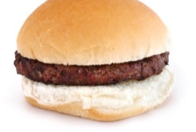


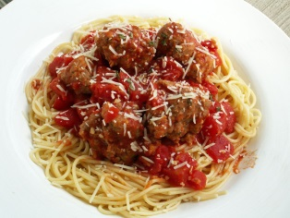
Menu Example 9-12
Choose 1: Hamburger/WW Bun or 1/2 c Spaghetti w/2 oz. Meat Sauce & WW Roll 1 oz.
Choose 2: Corn, Broccoli, Carrots (1/2 c each)
Choose 2: Orange, Banana, Apple Juice (1/2 c each)
Choose 1: FF Choc Milk or 1% White Milk
#2
#1
Reimbursable
#3
Milk
1/2 c Broccoli
Banana
Hamburger/WW Bun
1/2 c Carrots
Non-Reimbursable
Non-Reimbursable
1/2 c Spaghetti
2 oz. Eq. Meat Sauce
Banana
Notes:
At the top of this slide is a Sample Menu for grades 9-12.
Assume that the Hamburger meets the 2 oz. Equivalent for Meat/Meat Alternate and 2 oz. Equivalent for Grains.
-Let’s review some Examples:
#1 Hamburger/WW Bun & Carrots --- Reimbursable
(Since the Hamburger Meets 2 Complete Components, Meat/Meat Alternate and Grains and a ½ cup of Vegetable, the Carrots, was Selected ---- It is a Meal!)
#2 Milk, ½ c Broccoli & Banana --- Non-Reimbursable (Not 2 Complete Components. Neither Veg. nor Fruit Meets the Complete Required Component Size which is 1 cup.)
#3 1/2 c Spaghetti, 2 oz. Eq. Meat Sauce & Banana --- Non- Reimbursable (Not 2 Complete Components. Meat Sauce Meets Complete Required Component Size for Meat/Meat Alternate but a ½ cup Spaghetti is only 1 oz. Equivalent. For Grades 9-12 the Daily Minimum Grain Requirement is a 2 oz. Equivalent. The Sauce does Not Count as Anything Since the Menu Planner Does Not Include this Item as a Vegetable in their Planning.)

Slide 21




Menu Example 9-12
Choose 1: Hamburger/WW Bun or Hot Dog on WW Bun
Choose 2: Corn, Broccoli, Carrots (1/2 c each)
Choose 2: Orange, Banana, Apple Juice (1/2 c each)
Choose 1: FF Choc Milk or 1% White Milk
#4
#5
Reimbursable
#6
Hamburger/WW Bun
Milk
Hot Dog/WW Bun
4 oz. Apple Juice
Non-Reimbursable
Reimbursable
Milk
1/2 c Broccoli
Banana & Orange
Notes:
Again, Assume that the Hamburger and Hot Dog meets the 2 oz. Equivalent for Meat/Meat Alternate and 2 oz. Equivalent for Grains.
-Let’s review some additional Examples:
#4 Hamburger/WW Bun & Milk --- Non- Reimbursable (No Fruit and/or Vegetable was Selected.)
#5 Hot Dog/WW Bun & Apple Juice --- Reimbursable
(Since the Hot Dog Meets 2 Complete Components, Meat/Meat Alternate and Grains , and a ½ cup of Fruit, the Apple Juice, was Selected ---- It is a Meal!)
#6 Milk, ½ c Broccoli, Orange & Banana --- Reimbursable
(Since 1/2 cup of Vegetables, the Broccoli, was Selected along w/ 2 other Complete Components, 8 oz. Milk & 1 cup Fruit, the Banana & Orange ---- It is a Meal!)

Slide 22



Menu Example K-5 & 6-8
Choose 1: Hamburger/WW Bun or Pizza
Choose 2: Corn, Broccoli, Carrots, Green Beans (1/2 c each)
Choose 1: Peaches, Applesauce, Orange (1/2 c each)
Choose 1: FF Choc Milk or 1% White Milk
#1
#2
Reimbursable
#3
Pizza
1/2 c Broccoli
Hamburger/WW Bun
1/2 c Applesauce
Non-Reimbursable
Milk
1/2 c Broccoli & 1/2 c Carrots
Reimbursable
Notes:
At the top of this slide is a Sample Menu for grades K-5 and 6-8.
Assume that the Hamburger and Pizza meet the 2 oz. Equivalent for Meat/Meat Alternate and 2 oz. Equivalent for Grains.
-Let’s review some Examples:
#1 Pizza & ½ c Broccoli--- Reimbursable
(Since the Pizza Meets 2 Complete Components, Meat/Meat Alternate and Grains, and a ½ cup of Vegetable, Broccoli, was Selected ---- It is a Meal!)
#2 Hamburger/WW Bun & Applesauce --- Reimbursable
(Since the Hamburger Meets 2 Complete Components, Meat/Meat Alternate and Grains , and a ½ cup of Fruit, the Applesauce ,was Selected ---- It is a Meal!)
#3 Milk, ½ c Broccoli & ½ c Carrots--- Non-Reimbursable (Not 3 Components. The 8 oz. of Milk Meets the Required Milk Component Portion. The ½ c of Broccoli & ½ c of Carrots is More than Enough of the ¾ c Vegetable Component Requirement. For Grades K-5 & 6-8 ; But, there is no 3rd Component which in this case would have to be a Meat/Meat Alternate, Grain or Fruit.)

Slide 23
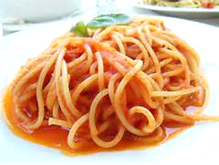


Menu Example K-5 & 6-8
Choose 1: Pizza or ½ c Spaghetti w/ 2 oz. of Meatballs
Choose 2: Corn, Broccoli, Carrots, Green Beans (1/2 c each)
Choose 1: Peaches, Applesauce, Orange (1/2 c each)
Choose 1: FF Choc Milk or 1% White Milk
#5
#4
Non-Reimbursable
#6
Milk & Pizza
1/2 c Spaghetti
w/Sauce
1/2 c Broccoli
Reimbursable
Milk
1/2 c Corn & 1/2 c Broccoli
Orange
Non-Reimbursable
Notes:
At the top of this slide is a Sample Menu for grades K-5 and 6-8.
Assume that the Pizza meet s the 2 oz. Equivalent for Meat/Meat Alternate and 2 oz. Equivalent for Grains.
-Let’s review some Examples:
#4 Pizza & Milk --- Non- Reimbursable (No Fruit and/or Vegetable was Selected.)
#5 Spaghetti w/ Sauce & ½ c Broccoli--- Non-Reimbursable (Only 2 Components. Plain Spaghetti Meets the Complete Required Component Size for Grains which is 1 oz. Equivalent for Grades K-5 & 6-8. The Broccoli Counts as the Required 1/2 c Fruit/Veg. There is No 3rd Complete Component. The Sauce does Not Count as Anything Since the Menu Planner Does Not Include this Item as a Vegetable in their Planning.)
#6 Milk, ½ c Corn, ½ c Broccoli & Orange --- Reimbursable
(Since ½ c of Fruit, the Orange ,was Selected along w/ 2 other Complete Components, 8 oz. Milk & 1 cup Vegetables, the Corn & Broccoli ---- It is a Meal!)

Slide 24
WEB SITES
http://www.fns.usda.gov/updated-offer-versus-serve-guidance-national-school-lunch-program-and-school-breakfast-program
For Examples of Signage Check Out Best Practices Sharing Center:
http://healthymeals.nal.usda.gov/best-practices
Notes:
-These are the web sites to refer to for additional information.

Slide 25


Thank you for attending the
Offer vs. Serve for Lunch webinar!
This webinar will count toward
1 hour of professional standards training:
Key Area- Operations
Learning Topic- Serving Food
Topic Code – 2220 Offer vs. Serve
Department of Agriculture
School Nutrition Programs
609.984.0692
www.nj.gov/agriculture
USDA is an equal opportunity provider and employer

